Slide 1

MSPM’S
Deogiri Institute of Engineering and Management Studies,
Aurangabad
Academic Year (2019- 2020)
Department of Computer Science and Engineering
Subject: Theory of Computation
Topic: Pattern Searching
Github ID: Manisha-shinde
Sandip7066
Submitted By
Sandip Wagh(36101)
Manisha Shinde(36102)
Under the Guidance of
Dr. S.M.Chavan
Asst.Prof. Department of CSE
(Deogiri Institute of Engineering and Management Studies)

Slide 2
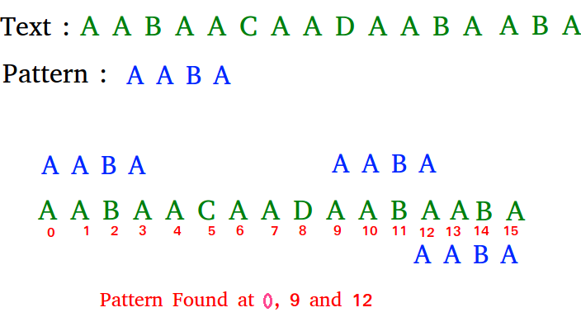
Introduction:
Pattern searching is an important problem in computer science. When we do search for a string in notepad/word file or browser or database, pattern searching algorithms are used to show the search results.

Slide 3
Naive algorithm for Pattern Searching:
Given a text txt[0..n-1] and a pattern pat[0..m-1], write a function search(char pat[], char txt[]) that prints all occurrences of pat[] in txt[]. You may assume that n > m.
Slide the pattern over text one by one and check for a match. If a match is found, then slides by 1 again to check for subsequent matches.

Slide 4
Objectives of pattern searching:
Naive pattern searching is the simplest method among other pattern searching algorithms. It checks for all character of the main string to the pattern.
This algorithm is helpful for smaller texts. It does not need any pre-processing phases. We can find substring by checking once for the string. It also does not occupy extra space to perform the operation.
The time complexity of Naïve Pattern Search method is O(m*n). The m is the size of pattern and n is the size of the main string.

Slide 5
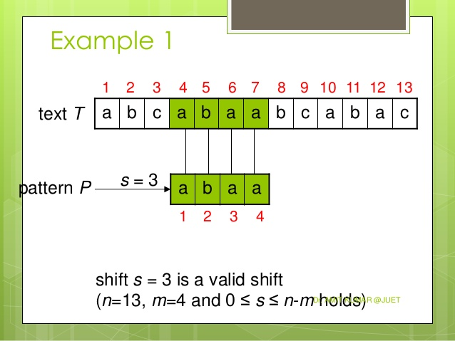

Slide 6
Application:
DNA Sequencing
Image Processing
String matching in bioinformatics
Digital Forensics

Slide 7
Program:
def search(pat, txt):
M = len(pat)
N = len(txt)
for i in range(N - M + 1):
j = 0
while(j < M):
if (txt[i + j] != pat[j]):
break
j += 1
if (j == M):
print("Pattern found at index ", i)
if __name__ == '__main__':
txt = "AABAACAADAABAAABAA"
pat = "AABA"
search(pat, txt)

Slide 8
Conclusion:
This algorithm is helpful for smaller texts. It does not need any pre-processing phases. We can find substring by checking once for the string. It also does not occupy extra space to perform the operation.

Slide 9
Thank You….

